Slide 1

POOR PERFORMANCE MANAGEMENT ISSUE LEADING TO REVENUE FAILURE IN THE RETAIL INDUSTRY OF THE UK: A CASE OF TESCO

Slide 2
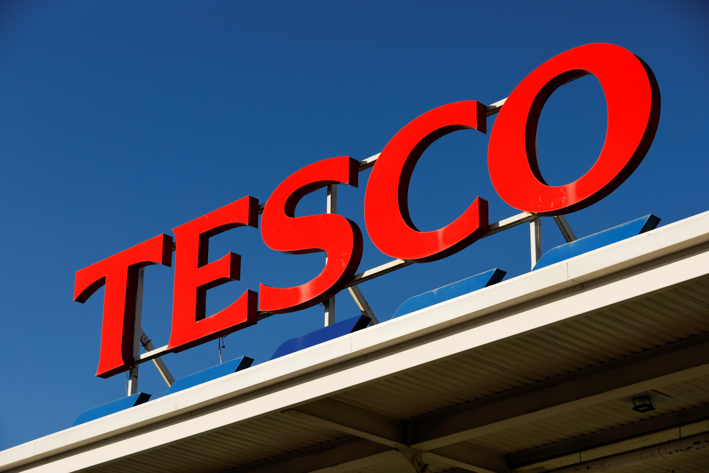
Introduction and Overview of Tesco
It has represented information on the British multinational retail company Tesco
It is one of the largest retail industry with more than 6800 locations
The company aim to serve healthy, affordable and sustainable food to customers
Notes:
Tesco is the leading multination retail company in the UK and it has been known as the largest retail industry with more than 6800 locations across Europe. The company serves their customers and the community in order to become more established and achieve a better opportunity. The main aim of the company is to serve the customer with good quality and affordable food effectively.

Slide 3
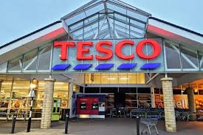
Issue of performance management of Tesco
The organisation faced issues regarding poor communication with the co-workers
A lack of skill and knowledge in employment has been evaluated in the work process
The issue regarding the lack of recognition (Mostaghel et al., 2022)
Notes:
In recent days, as the competition level has increased the company has faced such issues in managing performance. With a poor communication process, it becomes difficult for the employees to set goals and improve the work process. This highly impacts the work environment. Also, a lack of skill and knowledge brings difficulties to the individuals and it may decrease the productivity level. Showing recognition or appreciation for the performance of the employees is necessary which was being an issue for the company.

Slide 4
Research aim and objectives
Aim
The main aim of the study is to identify the impact of poor performance management issue that has been leading to revenue failure in the retail industry.
Objectives
To identify the particular issues of poor performance leading to revenue failure
To assess effective strategies regarding poor performance management in the retail industry
To develop the company by achieving the individuals' goals and company goals
Notes:
The aim is to identify the impact of poor performance in the retail industry and manage the revenue failure issue. In order to make the optimization of the poor performance management of the company which is leading to revenue failure and increasing difficulties. By identifying the specific issues regarding poor performance and executing effective strategies can utilize and increase the productivity level in the company.

Slide 5
SWOT analysis
Strengths Tesco is known as the largest grocery retailer in UK It has obtained many international awards It has growing number of stores across Europe | Weaknesses It has faced issues in the failed operation Issues in the financial operation Poor operational performance
Opportunities Emerging market opportunities Online shopping Expanding the business process | Threats Economical crisis Issues in supply chain management
Notes:
In the present study the strength, weaknesses, opportunities and threats has been observed. The strength of the company is that it is the largest retail company in the UK with growing diversified stires and attracting people more. It has obtained many international awards. As the largest company, it has also faced issues regarding failed operations in the financial process and poor performance. Also, it has obtained many opportunities such as in online shopping, emerging market opportunities and others. The threat to the company is based on the economic crisis and issues with the supply chain management.

Slide 6
PESTLE analysis
Vibrant political culture and the citizens takes an active role in democracy
Thorugh nominal GDP the UK is the 6th largest economy (Paulino, 2022)
Has the biggest customer market and has gradually influenced the social class
Technological sectors are the major contribute in the UK economy
The government, local councils and charities help in creating awareness to the environment
Notes:
The analysis has helped in providing the economic factors and using different tools for making the strategies update in the business procedure. It helps to increase the macro-environmental factors efficiently.

Slide 7
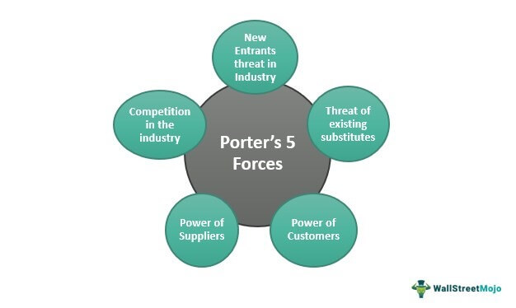
Porter’s 5 forces analysis
Representing competition level in the industry
It helps in analysing the new entrants' potentiality in the industry
Represents the power of suppliers
Represents the power of customers (Bushe, 2019)
It helps in identifying the threats of the substitute
Notes:
By the implementation process of Porter’s 5 force analysis, the understanding level in identifying the affecting factors regarding profitability can be achieved efficiently. This will highly guide in order to improve the business strategy and increase the competitive advantage.

Slide 8
Stakeholder analysis
It helps in understanding different attributes, interrelations and interfaces in the business
It helps in organising the planning tools for implementation
It highly provides team direction and team building
Notes:
Thorugh the stakeholder analysis process, Tesco can achieve its goals and increase its performance level. Ensuring the stakeholders can provide different ideas and planning techniques that can be included in the poor performance management and increase the revenue structure. Also, it provides high guidance in team direction and helps in developing a team.

Slide 9
Methodology and Ethics
Primary data can be conducted by obtaining different views and opinions form the company’s employees (Madhani, 2023)
It will highly help in gathering different aspects from workers and solve efficiently
The ethics of the ethical approval in accepting the review form, information sheet and questionnaires
Notes:
For making an improvement to the poor performance management of Tesco, individual opinions could provide guidance. The primary data can be included for generating several views from the employees and collecting information for the improvement process.

Slide 10
Project schedule
Activity | 1st May-10th May | 11th May-20th May | 21st May to 10th June | 11th June-20th June | 21st June-2nd July | 3rd July-20th July
Selecting Organization
Issues of the organization
Research objectives
SWOT Analysis
PESTLE analysis
Analysis of Porter’s 5 force model
Stakeholder analysis
Methodolological view
Scheduling
Final Submission
Notes:
In order to make poor performance management improve the project scheduling process will help in making the planning process more accurate. The time for the project will start from May to July.

Slide 11

Conclusion
The analysis of the stakeholder management can improve the quality of performance
The involvement of primary data can help to identify and gather effective ideas
Building teams and improving decision-making process for making communication effective can help in utilizing poor performance management
Notes:
From the above section, it has been found that the issues regarding Tesco has become increased in the competitive world and need improvement. By implementing effective strategies planning and analysis of stakeholder management can highly benefit the company. Also, building a team and improving the decision-making process by engaging every employee will make a positive outcome.

Slide 12
References
Tesco - Supermarkets: Online Groceries, Clubcard & Recipes (2023) Homepage. Available at: https://www.tesco.com/ (Accessed: April 28, 2023)
Mostaghel, R., Oghazi, P., Parida, V. and Sohrabpour, V., 2022. Digitalization driven retail business model innovation: Evaluation of past and avenues for future research trends. Journal of Business Research, 146, pp.134-145.
Paulino, E.P., 2022. Amplifying organizational performance from business intelligence: Business analytics implementation in the retail industry. Journal of Entrepreneurship, Management and Innovation, 18(2), pp.69-104.
Bushe, B., 2019. The causes and impact of business failure among small to micro and medium enterprises in South Africa. Africa’s Public Service Delivery and Performance Review, 7(1), pp.1-26.
Madhani, P.M., 2023. Human Resources Analytics: Leveraging Human Resources for Enhancing Business Performance. Compensation & Benefits Review, 55(1), pp.31-45.

Slide 13


